Slide 1
New York Bestseller
From: Jan-03-2010 to Dec-29-2019

Slide 2

Have you ever asked “How are all these books the #1 New York Bestseller List?”

Slide 3

What is a Bestseller?
“A bestseller is a book or other media noted for its top selling status, with bestseller lists published by newspapers, magazines, and book store chains. Some lists are broken down into classifications and specialties (novel, nonfiction book, cookbook, etc.). An author may also be referred to as a bestseller if their work often appears in a list. Well-known bestseller lists in the U.S. are published by Publishers Weekly, USA Today, The New York Times, The Washington Post, and IndieBound.[1] Most of these lists track book sales from national and independent bookstores, as well as sales from major internet retailers such as Amazon.com and Barnes & Noble” -Wikipidia

Slide 4
New York Bestseller: Background
Top best seller books
Data includes Published Date, Book Genre, Title, Author, Price and Total weeks on the list
Every 5 weeks books are picked for Top sellers book
Data is from
https://www.kaggle.com/dhruvildave/new-york-times-best-sellers

Slide 5
Preparation and Data Cleaning
Loaded the libraires
-import pandas as pd
-import matplotlib.pyplot as plt
-from google.colab import drive
imported date from excel to google drive and created a path of where to find the data.
-import seaborn as sns
Saved data into google drive and created a path to import the data for cleaning
- path= '/content/drive/MyDrive/Bestsellers/bestsellers books.csv'

Slide 6
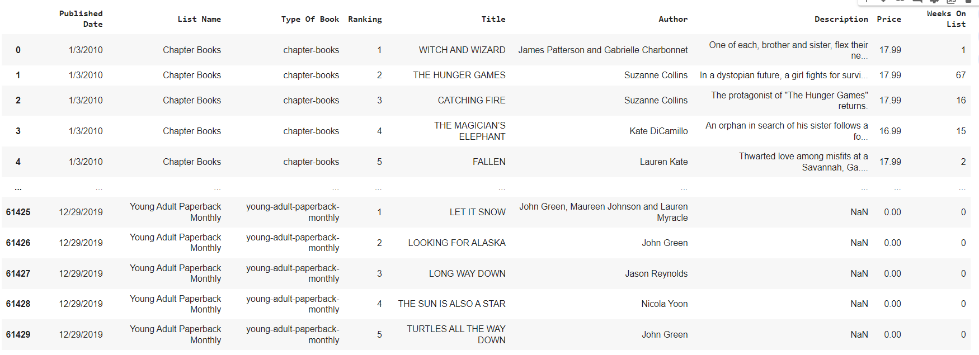
Data set
A snippet of what the data looks like after cleaning the data and eliminating columns that is not needed. Data set size is about 61,430 Rows and 12 Columns.

Slide 7
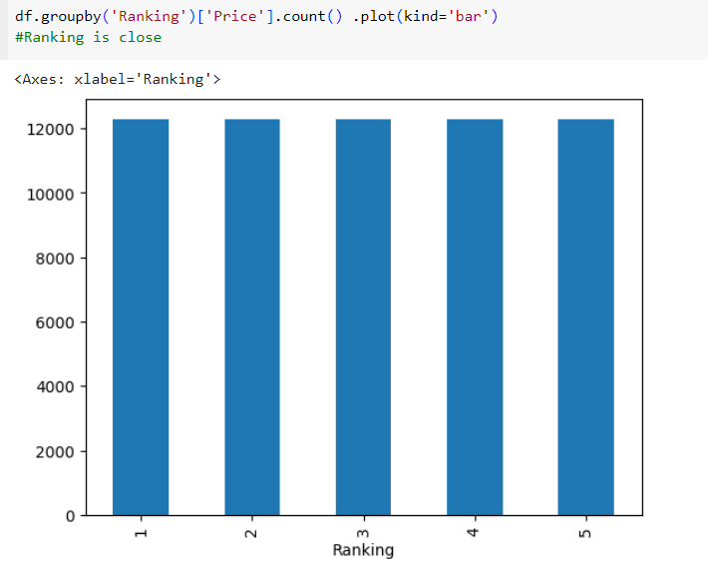
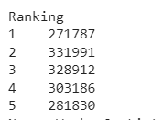
Why not look at the Ranking?
Tried looking at the price vs ranking to figure out if that will allow me to conclude the bestsellers. As you can see they are all highly ranked from scale 1-5, So looking at ranking will not help me determine the bestsellers. Also the ranking numbers are very close.

Slide 8

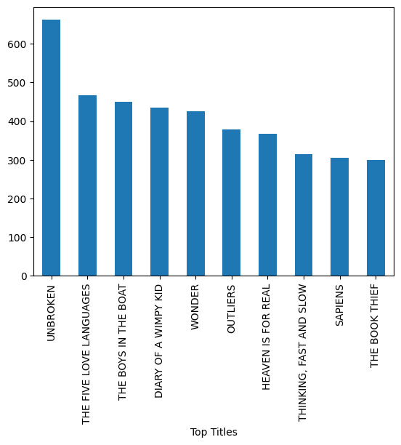
Books on Bestseller list
The #1 leading book for the Title category is Unbroken by Laura Hillenbrand. It is a biography of a WW2 veteran.
Who survived a plane crash, spent time on a raft, and was held captive. It’s a book about resilience, survival and redemption.

Slide 9

Type of Books
series-books 395960
paperback-nonfiction 164064
paperback-advice 127221
picture-books 123442
trade-fiction-paperback 108088
paperback-graphic-books 75611
advice-how-to-and-miscellaneous 70817
paperback-books 43693
combined-print-and-e-book-nonfiction 42251
childrens-middle-grade-hardcover 40985
hardcover-graphic-books 37490
young-adult 36088
e-book-nonfiction 33479
hardcover-nonfiction 30125
young-adult-hardcover 24302
combined-print-and-e-book-fiction 23142
mass-market-paperback 21998
hardcover-fiction 20993
childrens-middle-grade 20214
chapter-books 14339
manga 13313
e-book-fiction 12606
childrens-middle-grade-paperback 10878
hardcover-advice 10330
These are categories of books that are on the New York best seller list. This also shows how many times these type of books appeared on the list. As you can see series books has the highest number of appearance on the list

Slide 10
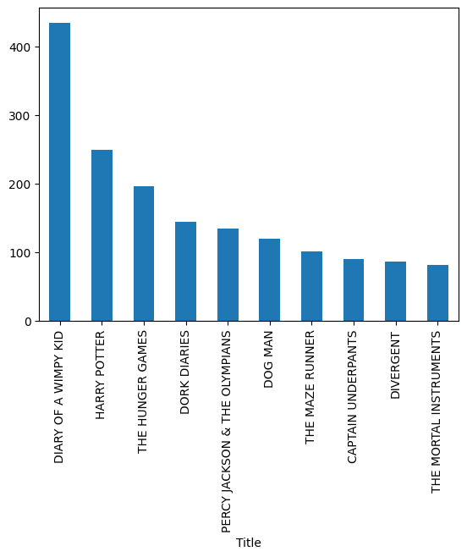
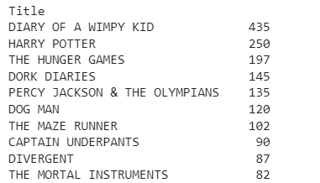
Series Books Bestsellers
The top 10 bestselling series titles all spent over 80 weeks on the bestseller list, with the top two over 200

Slide 11

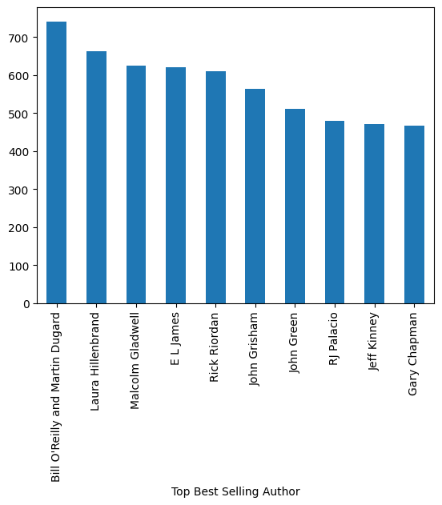
Top Bestselling Authors
These Authors have books in the series genre as well as Titles in the number of times in the weekly appearance.

Slide 12
conclusion
If a book makes 1 time on the Newyork bestseller list will always have that title it does not matter how long they have been on the weekly list.
There is a lot of different ways that Authors can get on the list(Title, Series, or just been an Author all together.
From the data I was able to learn that Ranking is not a factor in deciding who is on the list.
I also noticed that Authors, Series, and Titles appeared multiple times. So that means they were on there week after week

